Slide 1
Can Self-Reported Health Help
Predict Medical Costs?
(And Ultimately Help Picwell?)
Amy Danoff
June 8, 2018

Slide 2
Overview
Introduction
About the study design & data set
Descriptive analysis
Model comparisons
Conclusion + Recommendations

Slide 3
Introduction
Picwell’s base models predict out-of-pocket (OOP) costs in a health plan from a user’s age, sex and prescription drug use.
During the Fall 2018 open enrollment period, Aon will include survey questions that ask users to report their self-assessed health status, but Picwell’s predictions will not be using these survey questions.
Research question: Do self-assessed health survey questions improve health care cost prediction models?
Answer: Yes, to an extent, but with limitations
Utility for Picwell: Should Picwell consider incorporating the responses for self-assessed health survey questions into its cost predictions?

Slide 4
Study Design
Use data from the Medical Expenditure Panel Survey (MEPS) to estimate cost prediction models.
Compare various model performance metrics for a base estimation model, based on Picwell’s current model, and for a model including self-reported health as a feature.
Base Estimation model features: Age, Sex, Diagnosis

Slide 5
What is the MEPS data?
MEPS Data Overview:
The Medical Expenditure Panel Survey (MEPS) is a large-scale panel survey of individuals, families, and health-care providers in the United States.
2 Major Components: Household and Insurance
Household Component
Self-Reported survey responses from US families on demographics, health status, insurance status, expenditures, etc.
Intended to be a nationally representative subsample
Survey is answered by one respondent per household for each member of the household
Broken down on a biennial basis; survey questions asked in 5 rounds over 2 years

Slide 6
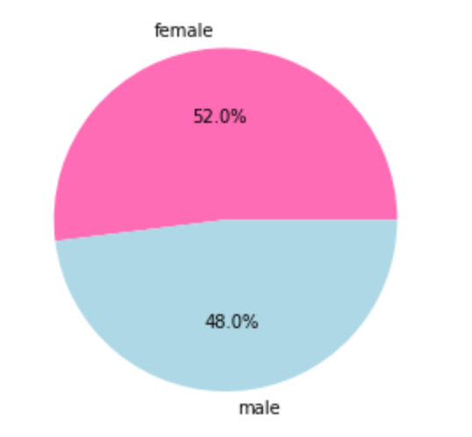
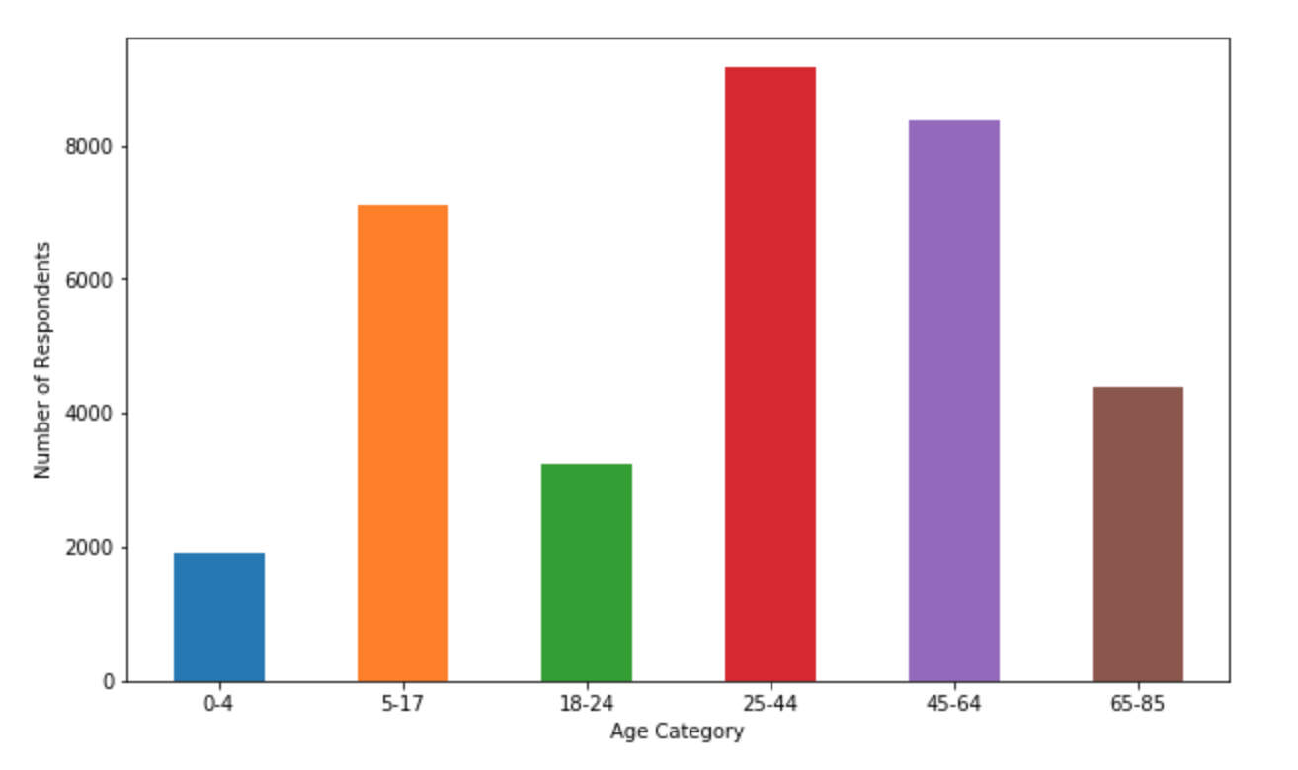
MEPS Summary Stats
2015 MEPS Household Component Data At A Glance:
35,427 Respondents (Total)
34,196
Respondents (Used)
(Dropped: Those who did not report self-assessed health)
.97
Avg. Diagnoses Per Respondent
9
Total Diagnoses
2.19
Avg. Self-Assessed Health on a 1-5 Scale (1=Excellent, 5=Poor)

Slide 7
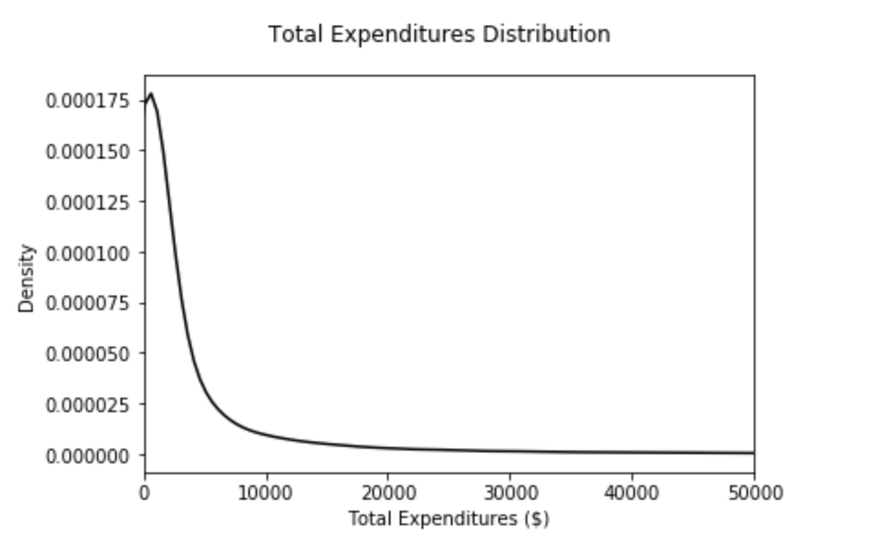
Overall Spending and MEPS Data
Spending Manipulation:
Truncated Costs at $250,000 (9 total entries originally over this threshold)
Majority of Responses had low/no spending

Slide 8
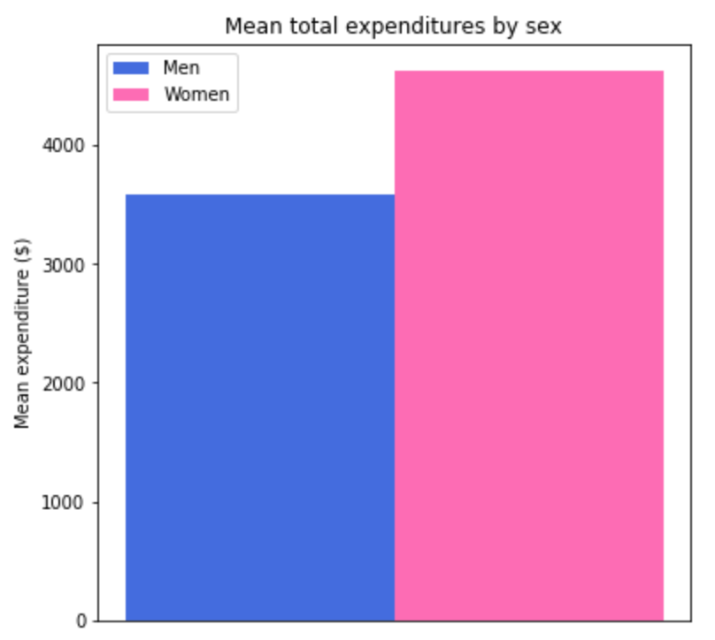
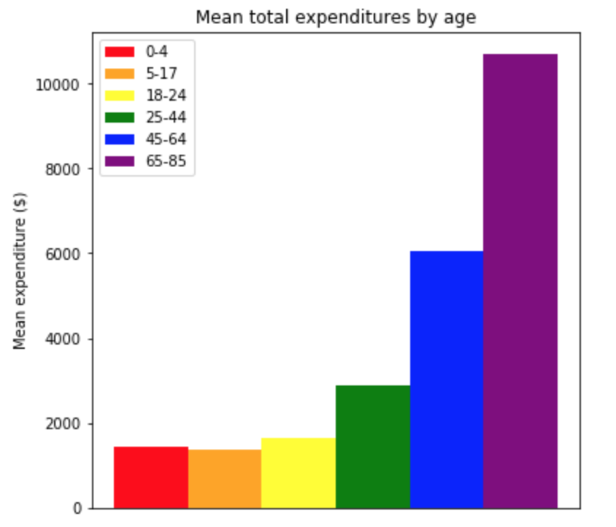
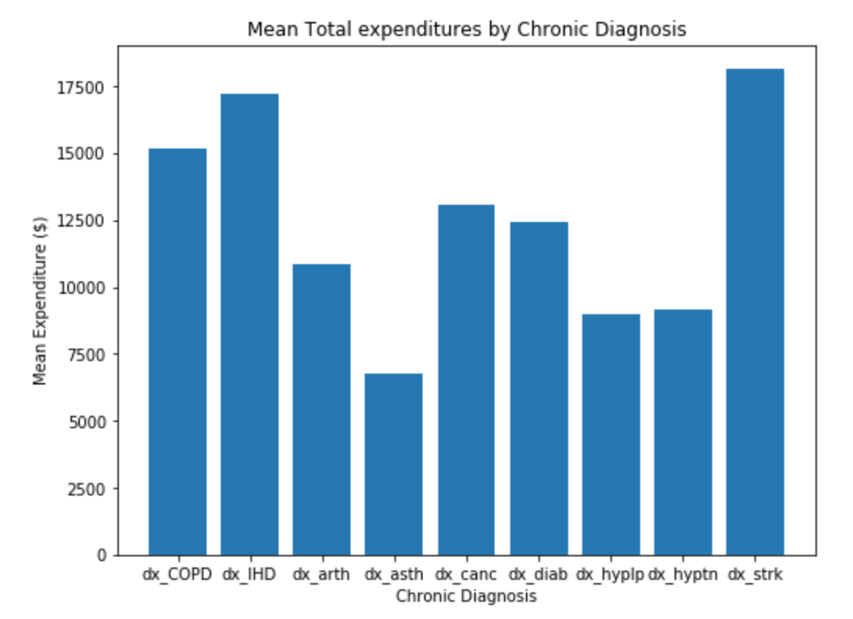
Overall Spending w/r/t Age, Sex, and Diagnosis

Slide 9
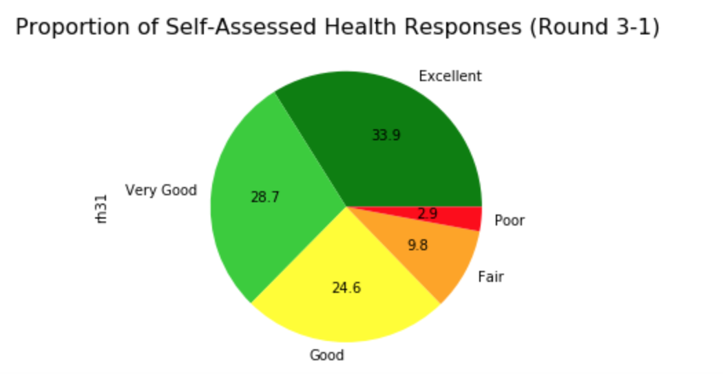
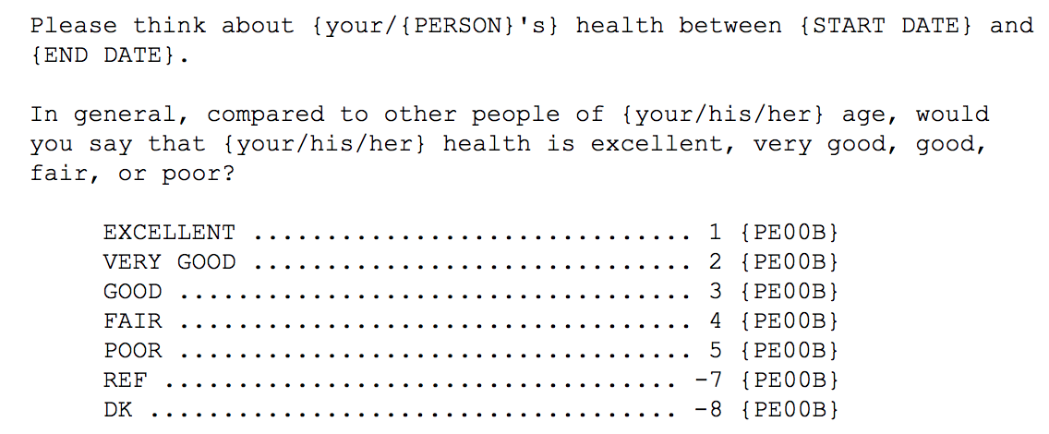
Self-Assessed Health at a Glance
Collected biennially in 5 rounds of surveying
Looking at Round 3-1: Beginning of 2015
Self-Assessed Health as Predictive

Slide 10
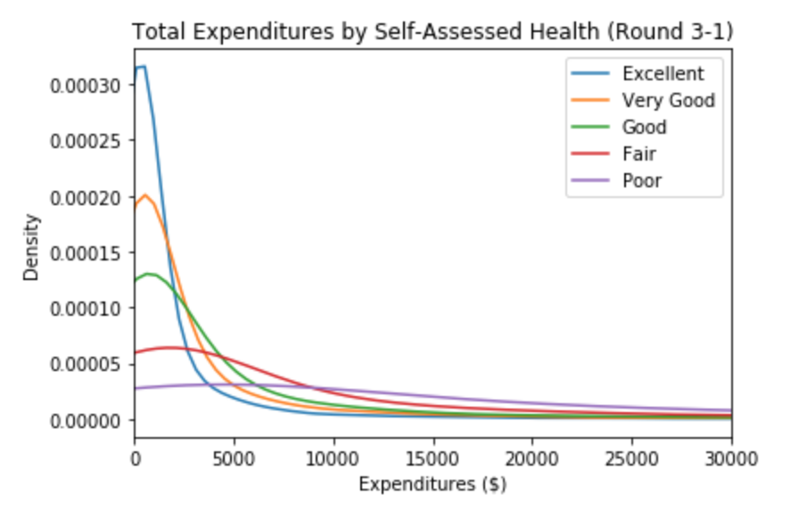
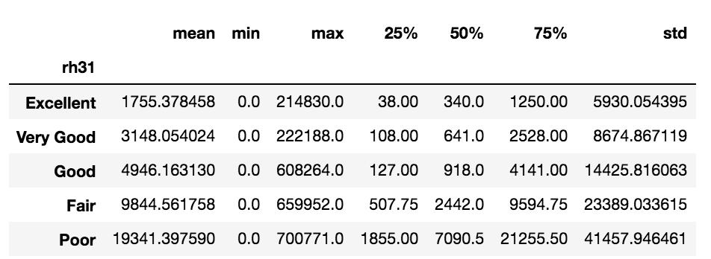
Self-Assessed Health at a Glance
Expenditures and Self-Assessed Health
Larger standard deviation, higher IQR as self-reported health declines
This is generally what we would expect
“Excellent”, “Very Good”, and “Good” thresholds are more similar than other categories
Relevant Statistics - Total Expenditures and Self-Assessed Health

Slide 11
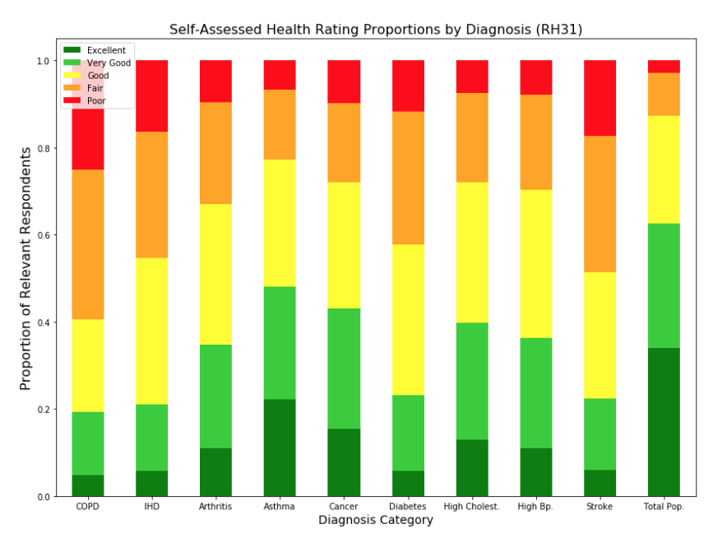
Proportions of Self-Assessed Health by Diagnosis
9 Diagnoses as subset of 15 most prevalent Diagnoses

Slide 12
Prediction Model Overviews
Random Forest Model - Regression and Classification
Two Model Variants:
Base Model (Age (Categorical), Sex, Diagnosis)
Diagnosis Categories as a stand-in for Picwell’s Rx Features
Base Model + RH
Regression Model:
Continuous output - predicted total expenditures
Classification Model:
Binary output - “True” for those predicted to have expenditures in the top 10% of true total expenditures for full dataset

Slide 13
Random Forest Regression Model Parameters
About the Model:
Sklearn.ensemble RandomForestRegressor
Model Parameters:
n_estimators = 20
min_samples_leaf = 100
max_features = 0.9
training set = 80% of data
Note - model tuning not subject to rigorous metrics
Notes:
Add results from the prediction models. This can cover several slides if you have a lot to report here.
Not sure on the right format, but think about starting by reporting results of each model separately. Results can include R-squared and mean error and mean absolute error. In you talk, recap for the non-analytics audience what each of these variables tells us. If you have it, you can also show feature importance tables or charts.

Slide 14
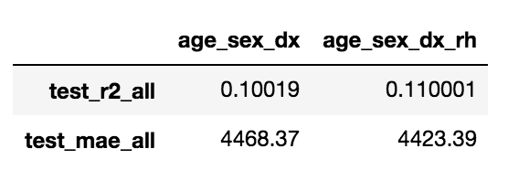
Random Forest Regressor Overall Performance Indicators
Overall Performance Indicators on Full Test Set:
R-Squared (Coefficient of Determination) by Model Variant
Mean Absolute Error by Model Variant
RH slightly improves overall model performance vis-a-vis R2 and MAE
9.8% Increase
1% Decrease

Slide 15
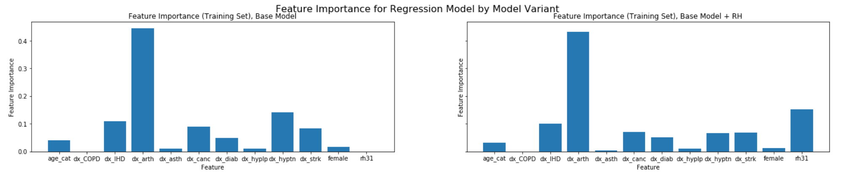
Random Forest Regressor Feature Importance
Feature Importance by Model Variant
Feature Importance - Decrease in Variance
Outsized importance of Arthritis
RH as second most important feature in model variant with RH

Slide 16
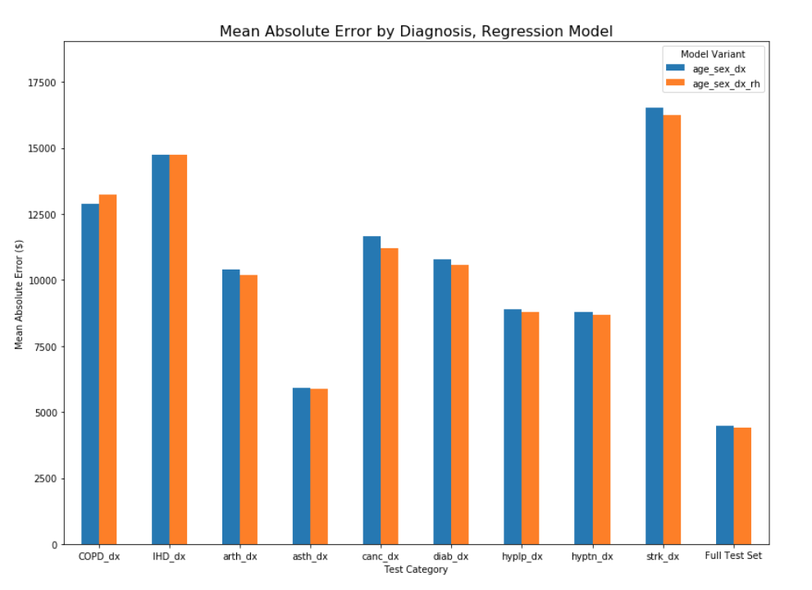
Mean Absolute Error - Random Forest Regressor
Mean Absolute Error by Diagnosis Categories
MAE proportional to true mean spending
Adding RH to model decreases MAE in all but 1 diagnosis category (COPD)

Slide 17
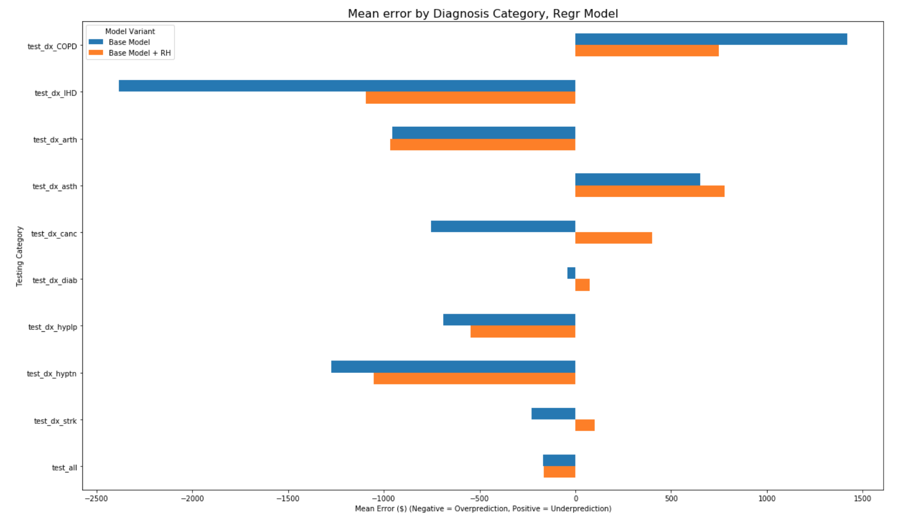
Mean Error - Random Forest Regressor
Mean Error by Model Variant and Diagnosis Category
Both Model Variants Underpredict Expenditures in 6/9 Diagnosis Categories
Adding RH Increases Mean Error for 6/9 Categories

Slide 18
Classification Model Parameters
About the model
sklearn.ensemble RandomForestClassifier
Binary output
Trained on output that is “True” if the total expenditures fall within the real top 10% of expenditures for full dataset.
Model Parameters:
min_samples_leaf = 5
n_estimators = 20

Slide 19
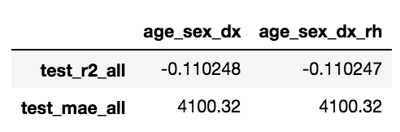
Classification Model Overall Performance Indicators
Mean Absolute Error stays the same
R2 stays essentially the same
Negative R2 value - Model does not decrease variance in errors for predicting the top 10% for either variant
May be because it is difficult to predict who will be in the top 10% of expenditures
Effectively no change
No change

Slide 20
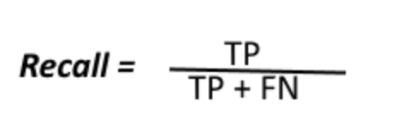
Classification Model Overall Performance Indicators
Confusion matrix
Adding RH to model decreases “False Negatives” - people who are predicted not to be in the top 10% but actually are, at the cost of increasing "False Positives” - people reported to be in the top 10% of expenditures who actually are not.
Ideally, we want “False Negatives” to be around 5%.
Base model - 9.2%
Base + RH model - 9.0%
Base Model
True Negative 6098 | False Positive 57
False Negative 632 | True Positive 53
89.9% Accuracy
Base Model + RH
True Negative 6090 | False Positive 65
False Negative 615 | True Positive 70
90.1% Accuracy

Slide 21
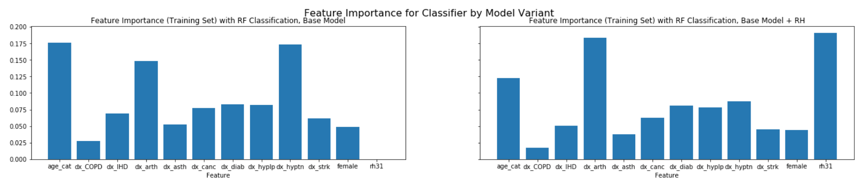
Classification Model Feature Importance
Outsized importance of Arthritis
Similar to Regressor Model feature importance
RH becomes most important feature when added to model
RH as much more correlated with identifying high spenders

Slide 22
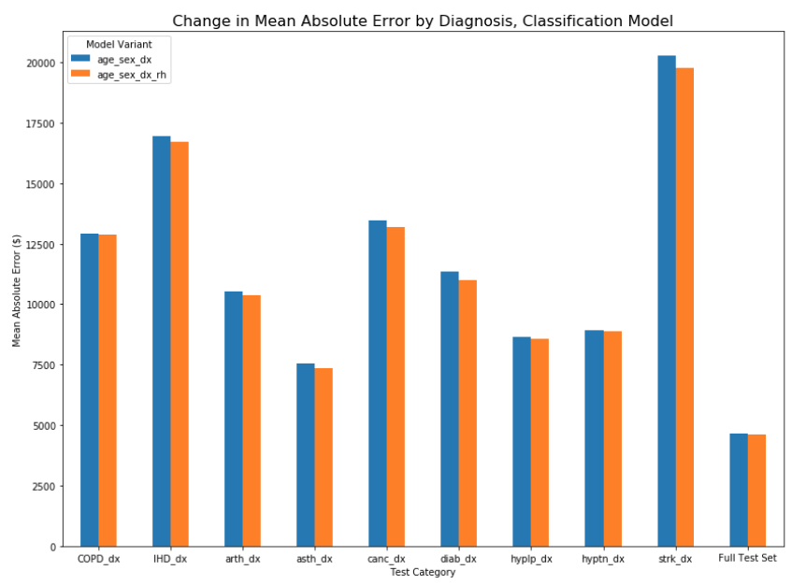
Classification Model Mean Absolute Error by Diagnosis
Slight Decrease in Mean Absolute Error within each Diagnosis category for model variant with RH added
MAE constant for full test set

Slide 23
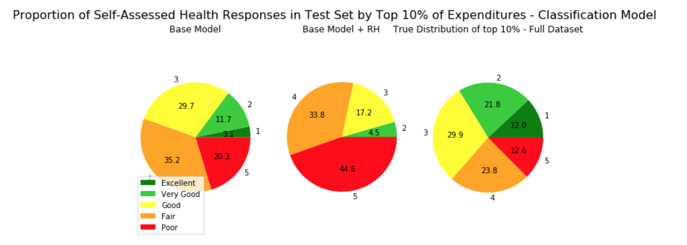
Classification Model Breakdown by Self-Reported Health
Breakdown of people who were predicted to have expenses that fall in the top 10% of total expenses for full dataset
Model with added RH significantly overpredicts the proportion of people in Good/Fair/Poor health in top 10% of expenditures
Or underpredicts for those who report Excellent or Very Good

Slide 24
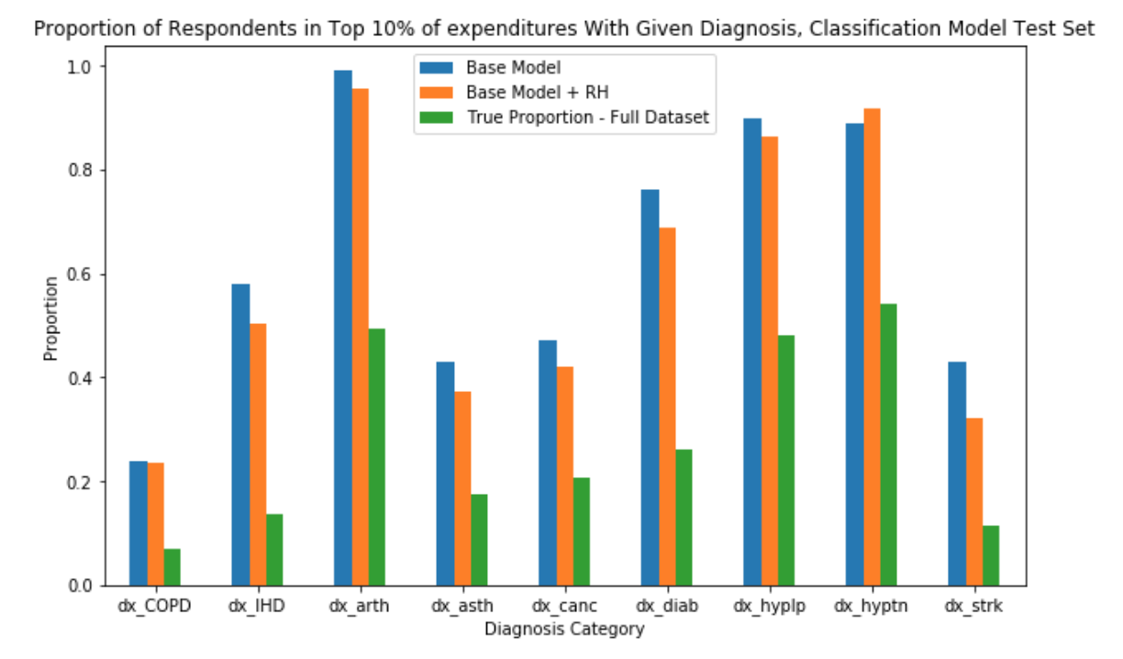
Classification Model Breakdown by Self-Reported Health
Adding RH to model makes proportion closer to the True proportion for every category except Hypertension
Does not decrease much for COPD - COPD has a high proportion of people reporting “Poor” health
Overweighting Arthritis/ Hypertension/Hyperlipidemia
Their mean costs indicate they are likely not overwhelmingly expensive, as compared to other diagnoses

Slide 25
Model Comparison
Adding RH to model variant slightly improved overall metrics for both Regression and Classification Models
Regression Model analysis predicted that RH would, overall, help slightly in more accurately predicting continuous Expenses
Classification Model analysis predicted that RH would, overall, help slightly in identifying who was in the top 10% of all expenditures
May overweigh RH in making this decision
Biased results for diagnosis categories with a large proportion of respondents who self-reported “Poor” health (COPD)
Biased results for diagnosis categories with a larger population of respondents (COPD, Hypertension, Hyperlipidemia)

Slide 26
Overall Conclusion - Self-Reported Health Appears to Improve Model Performance (With Reservations)
Utility for Picwell: Should Picwell consider incorporating the responses for self-assessed health survey questions into its cost predictions?
Indicated that RH has potential to improve models. Need further research into how to weight it.
Recommendation - further Research on the topic could follow up on the limitations or observed weaknesses of this study

Slide 27
Potential Next Steps
Self-Predicted Health as Binary
Plot AUC-ROC to better evaluate predictive power of Classification model
Investigate Arthritis
Predict Model with Rx instead of Dx
Re-tune model parameters
What puts people who say they are in excellent health in the top 10% of expenditures?
External Validity of Study

Slide 28
Questions?

Slide 29
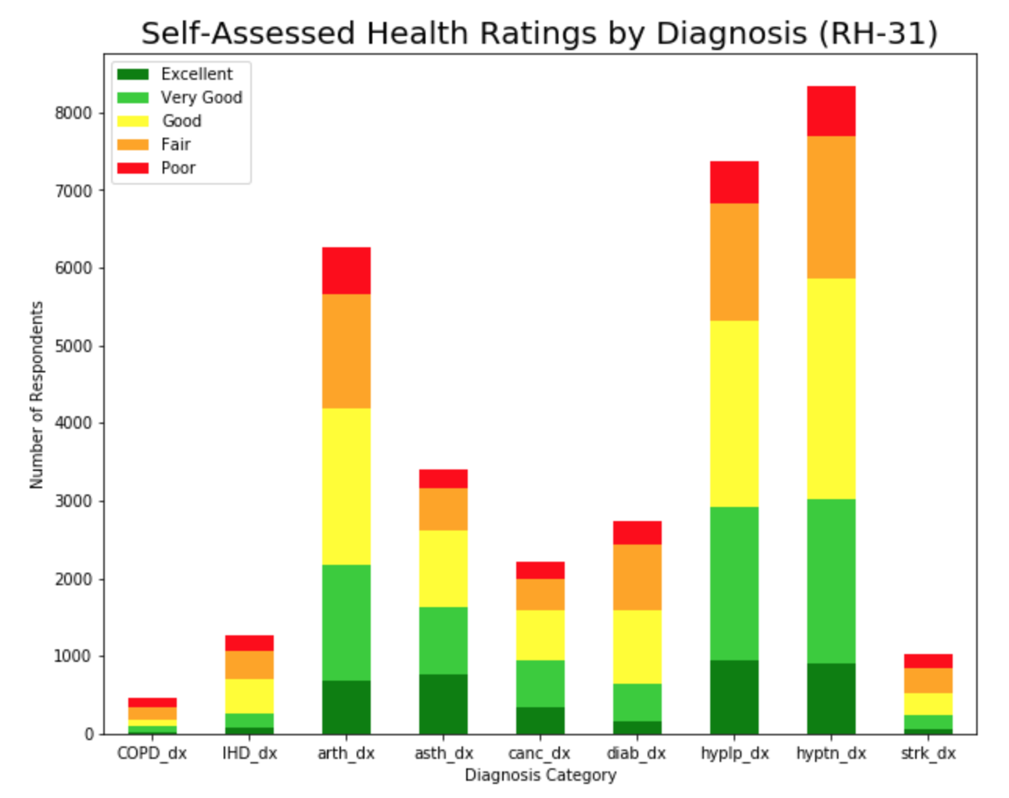
Self-Assessed Health Rating By Diagnosis (Absolute)

